Slide 1
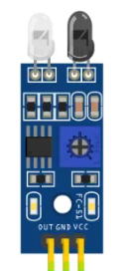
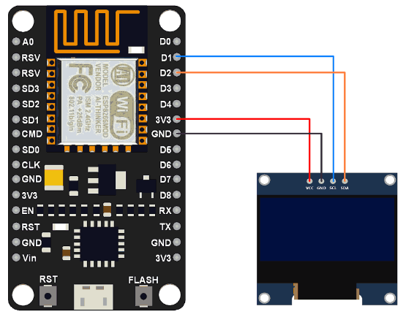
System 01: Parking Slot Detection System

Slide 2

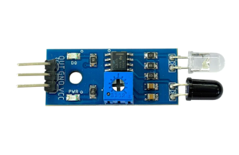


System 02: Authentication and API Connection
Information from IR Sensor to The ESP
Information from ESP to Blynk API

Slide 3
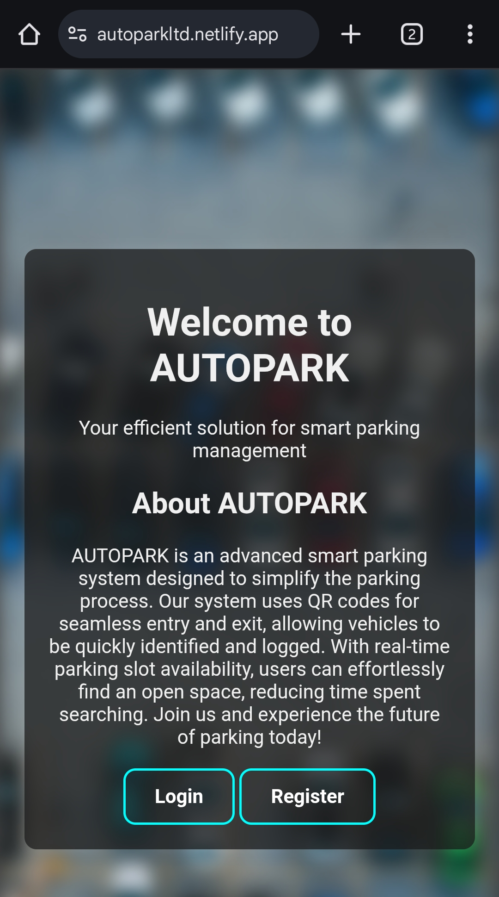
Blynk API
ESP8266
AUTOPARK Website

